Slide 1
What can we learn about communication, teamwork, and diversity from TTRPGs?
Tabletop role-playing games (TTRPGs)
Legal Stuff: This content and group is not affiliated with, endorsed, sponsored, or specifically approved by Wizards of the Coast LLC. Dungeons & Dragons® is a trademark[s] of Wizards of the Coast. For more information about Wizards of the Coast or any of Wizards' trademarks or other intellectual property, please visit their website at (www.wizards.com).

Slide 2




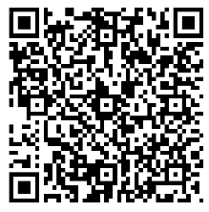
Tabletop Role-Playing Games at Work for Fun & Profit
Nina Navazio (she/her)
Content Designer
Christine Assaf (she/her) MAIOP, SPHR
HR Consultant
Survey and Q&A
www.aka.ms/
TTRPGsForFunAndProfit
Deepti Vaidyanathan (she/her)
Software Engineer
William Assaf (he/him)
Senior Content Developer
Notes:
<nina>
Welcome everyone!
As we get started please feel free to fill out our anonymous survey. We have just a few questions about TTRPGS and we're also inviting anyone who wants to play to join us at 2:30p at the free play tables for a quick TTRPG game. If you're interested, please let us know on the survey, and again, it’s totally anonymous.
--
Ok, let's go ahead and get started. Welcome to our panel, Table-top roleplaying games at work for fun and profit. My name is Nina Navazio and I'm a Content designer at Microsoft—I write the words on the screen, working with designers to build intuitive experiences. I've been a Dungeon Master since high school, and I love playing new systems and games with interesting mechanics and very little combat. I'm joined by a wonderful group of peers—Christine? …. Deepti? …. William?

Slide 3
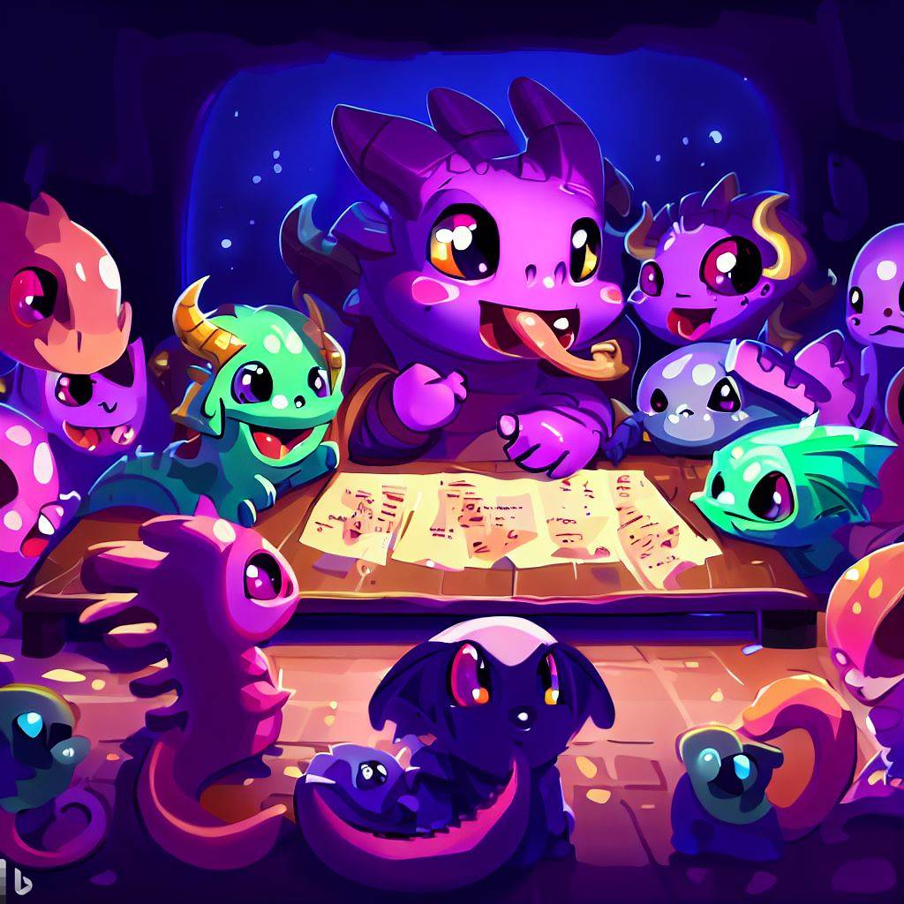
Agenda
Teamwork
Professional communication
Diversity
Emotional Intelligence
Bringing TTRPGs to your work
Q&A
Survey and Q&A
www.aka.ms/
TTRPGsForFunAndProfit
Notes:
<William>
Hi everyone. To answer first question: What am I going to get out of this presentation?
This will be relevant to you if you’re a team member or a team leader, or if you’ve played D&D in any capacity. So, everyone. This will be relevant to everyone at PAX.
We'll start with talking about Teamwork and exploring the shared skills in a team dynamic and at a gaming table. We hope you’ll observe many of the same parallels.
Then we’ll move on to professional communication, how what we do at the gaming table prepares us for what we do at work.
We’ll talk about the importance of diversity, and how at Microsoft, complex teams are needed to solve complex problems. We’ll talk about how bringing our whole selves to work is critical, how it unblocks our creative work.
Finally we’ll define and discuss the skills involved in practicing emotional intelligence. Tabletop games are a way for us to practice and refine our emotional intelligence skills, which are work skills..
At the end we’ll talk a bit about how we play D&D at Microsoft, and in the Q&A, we’ll have time after the panel to answer your questions about gaming and work. You can use the microphones or send in your questions anonymously through the survey link here on the screen.
(include information about microphones, anything else logistical we need to say)
<I’ll turn it over to Deepti to get u started.>

Slide 4
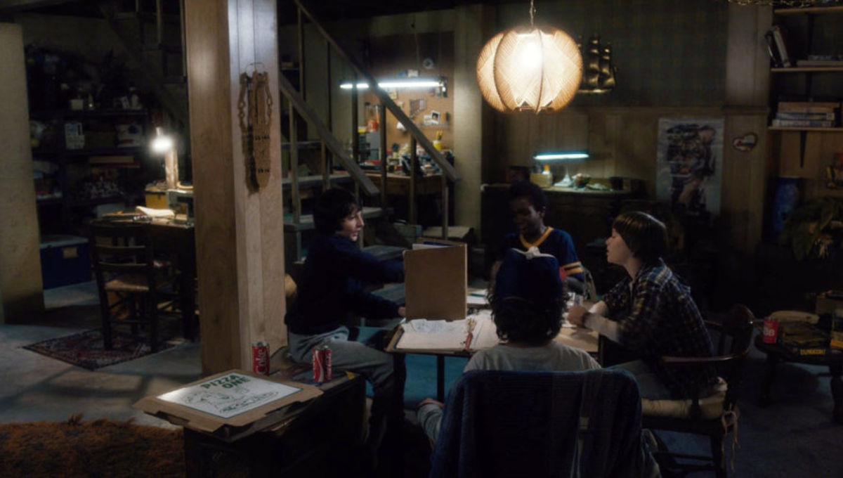
What is a tabletop role-playing game (TTRPG)?
Stranger Things (season 1, episode 1)
Legal Stuff: This content and group is not affiliated with, endorsed, sponsored, or specifically approved by Wizards of the Coast LLC. Dungeons & Dragons® is a trademark[s] of Wizards of the Coast. For more information about Wizards of the Coast or any of Wizards' trademarks or other intellectual property, please visit their website at (www.wizards.com).
Notes:
<Deepti>
Just as a quick introduction to TTRPGs, here are characters from Netflix's Stranger Things playing Dungeons and Dragons, and while usually table-top roleplaying games like this take place at a literal table-top, these days we also play it online with a virtual table-top, but the game and roles stay the same.
There are two roles people play within the group: the Players,
<click>
and the Main Storyteller
<click>
(also known as the Game Master or GM, but here we’ll use the phrase Main Storyteller).
In this image, the Main Storyteller has a book propped up in front of them and many resources they're using to help tell a story, and all the players have papers and binders in front of them to keep track of information about their characters. While the Main Storyteller is the referee in a sense who makes sure players follow the rules by the book, they aren't always adversarial. Together, the Main Storyteller and the players decide on house rules, what to do in the game, and they co-create the world and stories that make up the game that they're playing. They're telling a story together, which is the ultimate goal of most TTRPGs.
<pass to Christine to introduce empathy, a big part of emotional intelligence>

Slide 5
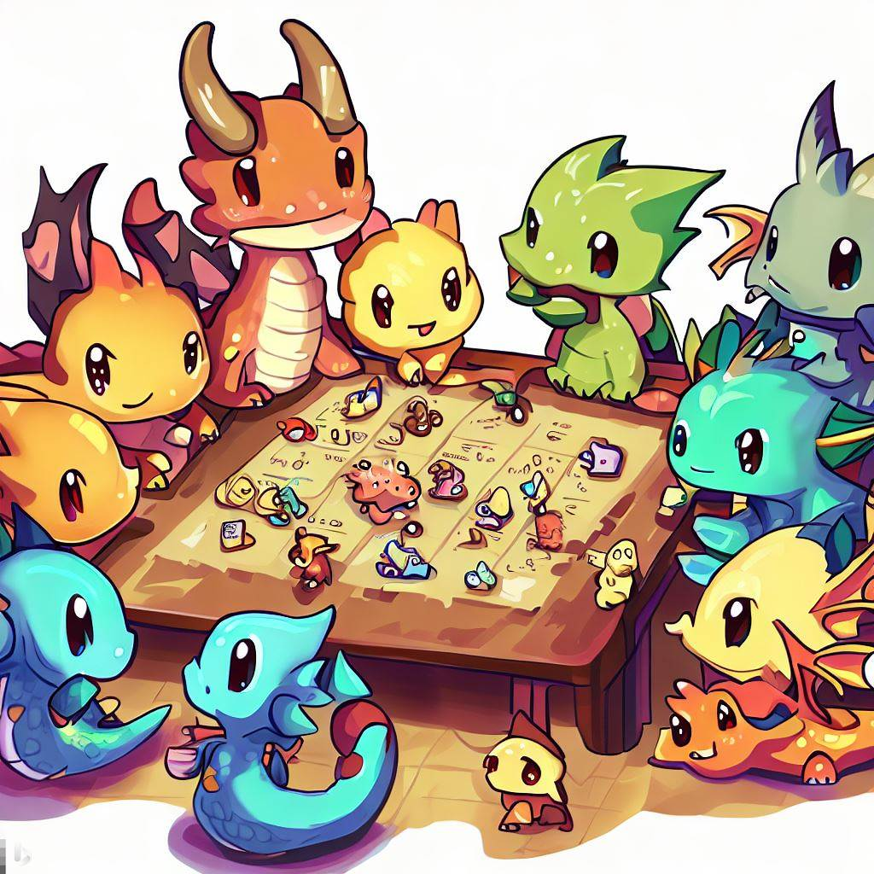
“Innovation comes from having a deep sense of empathy.”
Satya Nadella
Notes:
<Christine>
But before we jump into everything today, I'd like to take a moment to discuss a big part of our presentation today, empathy – which is a large part of Emotional Intelligence. And will go into this more later but generally, emotional intelligence is defined as the ability or skill to perceive, use, understand, manage, and handle emotions – one of those skills involves empathy. Empathy has a role in both playing games as well as business.
Per a 2009 study, Emotional Intelligence is responsible for 58% of job performance and 90% of top performers have a high degree of emotional intelligence…
CEO Satya Nadella is says:
“Innovation comes from having a deep sense of empathy.”
And that's really what all the stuff we'll talk about today boils down to: how you CAN learn empathy, a big part of emotional intelligence, in the safe environment of a TTRPG.
Of all the skills in concept of emotional intelligence... Empathy is the most commonly understood, and perhaps the most important. But we can practice the entire Emotional Intelligence skillset at the gaming table, and I hope you hear examples of that today.
That said, so let's get into Teamwork...

Slide 6
Roles in a TTRPG
Player
Main Storyteller
One of the main characters.
Has agency in a sandbox.
Doesn’t know what’s next.
Makes decisions “in character” based on “character knowledge” not player knowledge.
Co-creates the world and plot.
Improvises within fictional world.
Helps tell the story.
All other characters in the world.
Manages the sandbox.
Prepares for what could be next.
Makes decisions consistently, based on knowledge of the world and events to come.
Co-creates the world and plot.
Improvises within fictional world.
Helps tell the story.
Notes:
<nina>
To get a little more specific, here’s a quick breakdown if you’re new to the concept of a table top role playing game.
<click>
Each person has one responsibility: playing one character in the world. These are the “main characters” of the story, <click>
they have agency in the sandbox of the world, <click>
and while they don’t know what happens next in the story, they have a large degree of freedom to make decisions in this fictional world. <click>
They make decisions by playing the role of character, and because it’s fun, players often separate their “character’s” knowledge from their own player knowledge for some situational irony and often comedy.
On the other hand the Main Storyteller has more responsibilities: <click>
They run the entire world and all its other non-player characters, <click>
manage the goings on of the sandbox and its plot,<click>
prepare for the many possible decisions the players could make, <click>
and make decisions consistently about rules and story.
The Main Storyteller is a referee in some cases, but not necessarily an adversary or opponent. Though Main Storyteller does play as the enemies of the players in combat situations.
The Main Storyteller has an idea of the fictional world in their mind, and they create mysteries, monsters, and marvels throughout the world. But the Main Storyteller doesn’t do this alone. <click>
Since the player’s characters have their own agency, the Main Storyteller must balance their storytelling job with refereeing. Both roles co-create in the world. <click>
If a player does something unexpected, what happens next? Both roles improvise within the fictional world.
The Main Storyteller is tasked with both enabling creativity and cooperation, as well as providing the challenges, but everyone in the world helps tell the story. <click>
Everyone at the table works together to design goals, to agree on and follow rules, and to provide the psychological safety that fosters innovation and fun.
Now that we’ve introduced role-playing games and the metaphor we’ll be using today between gaming and business, I’ll turn it over to William to talk about Teamwork.

Slide 7
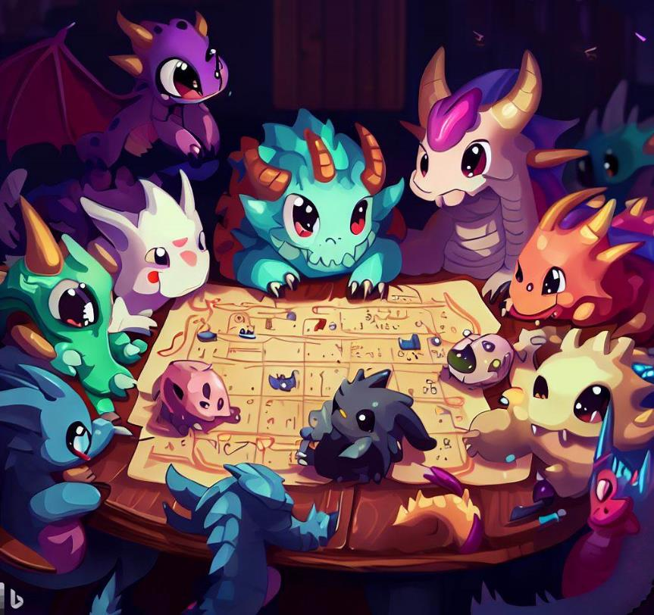
Teamwork
Teamwork | Professional Communication | Diversity | Emotional Intelligence | Bringing to Work | Q&A
Notes:
<christine>
Let’s talk about what we can learn about team dynamics from tabletop roleplaying games, including the value of veteran leadership, team motivation, problem solving, and conflict resolution.

Slide 8
Teamwork & Leadership
Skills & competencies that make a successful manager:
Human Relations
Competitiveness & Control
Fostering Entrepreneurship & Innovation
Order & Rationality
Notes:
<christine>
Some Organizational Psych researchers conducted a massive study of managers from over 150 organizations. And what they wanted to do here was identify the skills & competencies that make up a successful manager. And the results they got broke down to four basic clusters:
Human Relations: communication, providing support, team building
Competitiveness & Control: focusing on achievement & results
Fostering Entrepreneurship & Innovation: encouraging creativity and autonomy
Order & Rationality: maintaining control
Now what you may notice here, as the researchers did, that cluster 3 and cluster 4 are contradictory and paradoxical. Fostering innovation and entrepreneurships is the opposite of maintaining control. Yet, they discovered that successful leaders are those able to resolve this paradox. That even as they are maintaining control and stability they are able to foster and encourage creativity and flexibility. And I can’t think of a better way to describe a DM at a TTRPG than a person who is maintaining control but encouraging creativity among their players. As well as the players at the table becoming comfortable with this dynamic, which in turn, gives them the skillset to operate comfortably in that state. And if you're interested in reading this study, we can provide those links for you on developing management skills for decision makers.
<Transition to William>
Study: Cameron and Tschirhart (1988) https://cmls-global.com/wp-content/uploads/2018/02/Developing-Management-Skills-for-Decisions-Making.pdf

Slide 9
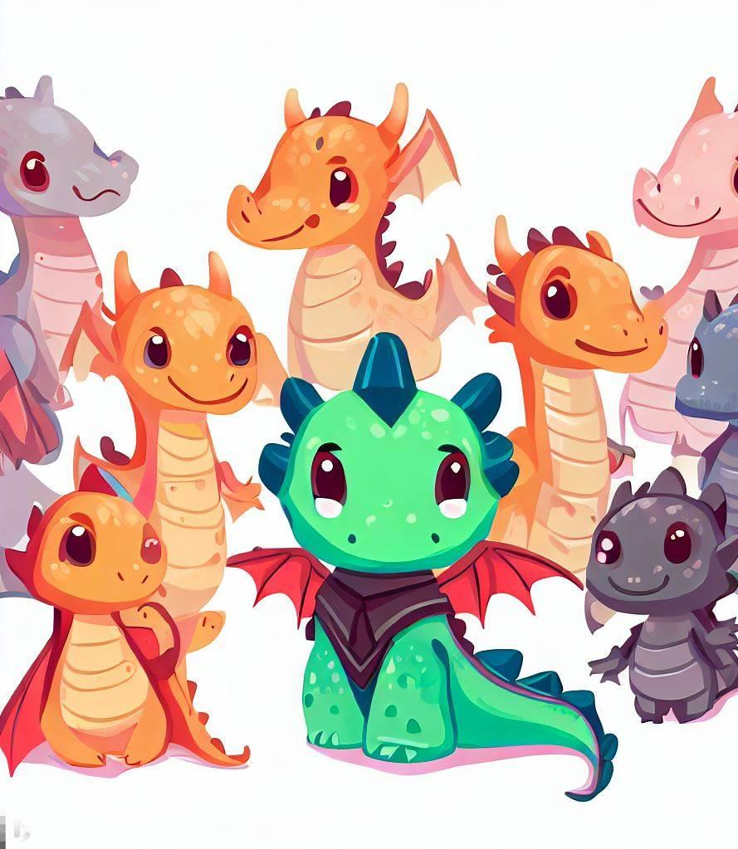
Veteran Leadership
Avoid knowledge bottlenecks
Exemplify tone, model behavior
Demonstrate freedom to be creative
www.aka.ms/TTRPGsForFunAndProfit
Notes:
<william>
Here’s where we get into some of my favorite parallels between professional teamwork and cooperative storytelling at the gaming table.
<click>
First, good groups combine veteran leadership with newcomers. This applies to both the table and the team.
When playing a TTRPG, the Main Storyteller could easily become a bottleneck for new players. If new players ask only the Main Storyteller about game rules, everyone suffers because the game slows down. But if veteran team members are present, willing, and able to help newcomers, then the load is distributed around the team. The Main Storyteller can focus on guiding the story while veteran team members show new players the ropes.
On a team at work, perhaps a software engineering team, a single manager will become a bottleneck for questions and how-to's. It's better if more experienced members of the team are able to walk devs through organizational processes, including codebases and architecture.
Team members might not feel comfortable asking "dumb" questions all the way up the chain, and would rather use a peer as a sounding board. Not to mention that this also saves the Manager and Main Storyteller a lot of time.
<click>
This is an important distinction between leadership and management. You can lead without being a manager, and you can be a manager even if you’re not the only leader.
Veteran players help establish the accepted tone and tenor of the gaming table and the status meeting. They show how to roll the dice, how to get into character, how to be creative. Veterans model behavior. They demonstrate how to interact with others, how to make requests, where to get the good coffee. Show don’t tell. That kind of info doesn't need to come from management.
But most importantly,
<click>
Veterans have the burden and the privilege to be exemplary, to demonstrate the freedom to be creative. That freedom is not something that everyone understands right away … leaders should demonstrate empowerment to be innovative, and to build on each other’s successes.
If you’re starting a new campaign, make sure you have a mix of players at the table, at least one veteran ally you can trust to be a good example, to lead by doing. Same thing if you were starting a new work team, you’d want some seniority mixed with the entry level folks.
Meanwhile, if you are in management of a team, or the Main Storyteller of a gaming table? Don’t you dare stand in the way of creative freedom - by laying down arduous rules, putting up walls to communication, or single threading the flow of information through yourself. That just makes more work for you, and less fun for everyone else.
I’ll handle it over to Deepti to talk about team motivation and the importance of creative work.
<pass to deepti>

Slide 10

Motivation
Creative work is intrinsically more motivating
Allow for process ownership and creativity
Empower creatives
www.aka.ms/TTRPGsForFunAndProfit
Notes:
<Deepti>
A team still needs to be motivated, and heuristic or creative work is intrinsically motivating.
The Main Storyteller provides an entire world for the players to explore, and ideally plenty of plot hooks for players to feel like their creative decisions matter in the scope of the story. In my job as a software engineer, I find myself drawn to tasks like working on design documents and bringing those designs to life in code, because I get to flex my creative muscles and I feel invested in the outcome of whatever solution I make.
Don't tell your team that they must to do x y and z. Tell them they need to get to z, and let them explore the possibilities of how to get there. Whether it's resolving a bug or slaying a dragon, think about the quests in your workplace or gaming table. Learn to recognize where constraints discourage innovation and creativity.
<click>
When leading a team or a gaming table, make sure to allow teams to have some ownership over creative processes. By doing so, you’re helping your team feel invested in whatever you’re working towards, whether that’s avenging a player character’s fallen family or designing a new feature in a product. Don't do all the creativity for them. Can you imagine how boring of a game it would be if the Main Storyteller was performing a monologue about how each character made these exact choices, to slay the dragon in this particular way, and using these specific spells?
<click>
Too often, our workplaces and gaming tables talk a big game about creativity and innovation, then immediately stifle it with rigid processes or old rules or poorly run meetings that waste everyone's time.
Instead, we should strive for supportive, co-operative, and creative teams and tables that let each member explore their ideas. Because more often than not, by letting the team find their own way on the path to Z, they will find solutions that you never even considered before, and that is where innovation starts.
<pass to Nina>

Slide 11
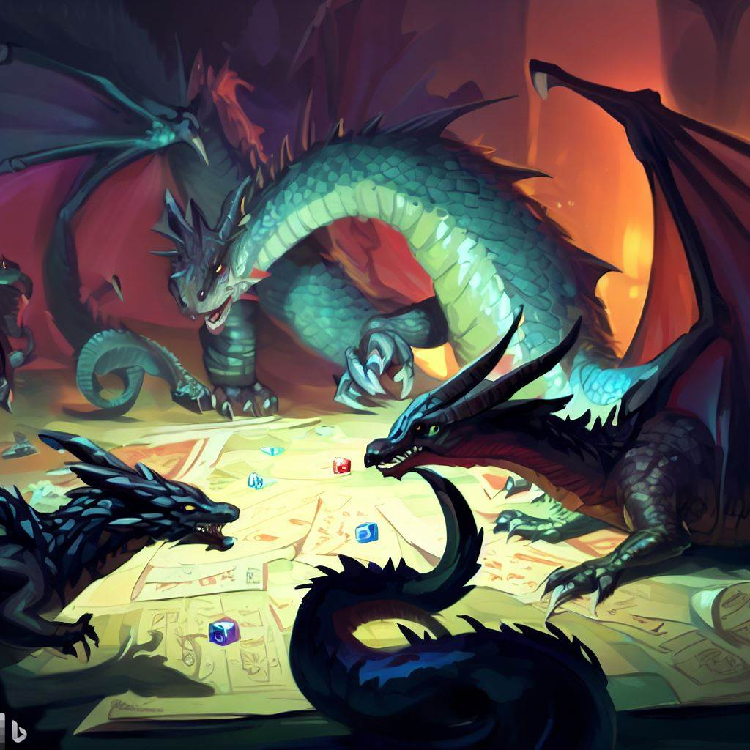
Problem Solving
Emphasize creative motivation and how to solve problems
TTRPGs abstract problems, so we can easily learn & see solutions
www.aka.ms/TTRPGsForFunAndProfit
Notes:
<nina>
Not only do TTRPGs emphasize the need for creative motivation, but it also lets us practice a muscle we use basically every day: problem solving.
Our real-life problems, like how to deliver a project on a timeline, can seem huge and overwhelming. But a side-quest to deliver a flower by a certain deadline to an Earl? Now that's exciting. TTRPGs can act as an abstract filter for our everyday worries—and help us figure them out in a safe space where it's OK to not deliver on time, but at the same time learn how we could've delivered and what we'll do better in the next quest. <click> Instead of feeling pressure from other teams, managers, or third parties, in a TTRPG you only feel pressure from... dragons, or Queens, or the imminent collapse of some mountain top you're on. These problems are still real, but it's much easier to take a step back and ask, "What should my character do?" Instead of getting caught up in all the emotions and stressors that would realistically overwhelm someone in a situation like that.
By practicing that skill of stepping back and asking, "What should I do here?" as well as working with your fellow players to figure out exactly what you should all do as a team, you are getting better at the transferrable skills TTRPGs are so good at teaching.
<pass to Deepti>

Slide 12
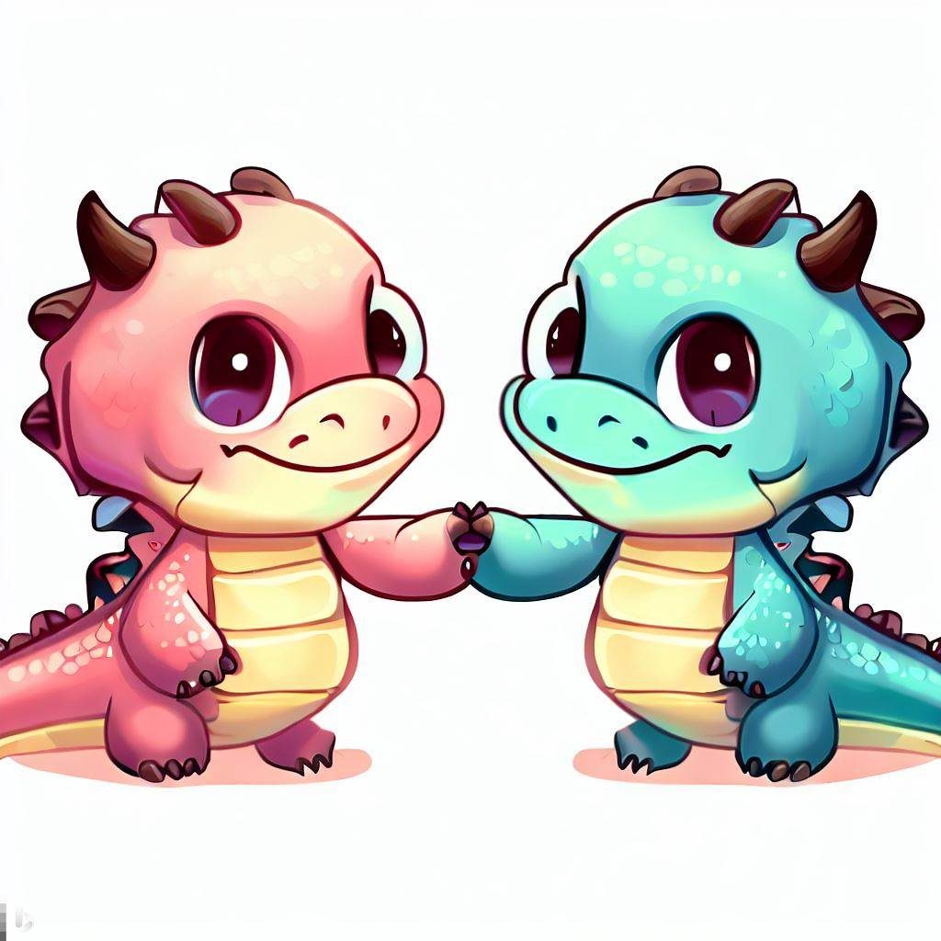
Conflict Resolution
Remind team of goals
Balance open discussion with decisiveness
Emphasize empathy
www.aka.ms/TTRPGsForFunAndProfit
Notes:
<Deepti>
Co-operative and creative teams are almost never in constant agreement, and whether your team is trying to infiltrate a castle or collaborating on a project there are bound to be some disagreements.
<click>
When your team is arguing with each other, as a leader its important in that moment to remind everyone of the team's ultimate goal in that discussion. As the Main Storyteller, if the PCs are getting a bit heated deciding how to fight the BBEG, you can remind them of what the ultimate goal of every TTRPG is: to tell a cool story together. It helps them remember that there isn't a single solution to whatever problem they're facing, as long as they're having fun they're "winning" the game! Similarly at work, refocusing your team on what needs to be delivered can turn tiresome arguments into productive discussions.
<click>
Whether you’re a Main Storyteller or a manager, you can help lead your team through conflicts by balancing open discussion and decisiveness. To ensure everyone has a voice at the table, its important that you understand how the power dynamics within your team may impact member participation. The new player at a table may not want to voice dissent against an experienced player’s plan, and similarly it can be difficult for a new-hire to question a more senior member of their team during a discussion. In my workplace, I’ve seen things like anonymous feedback forms, team member shout-outs, and the Teams hand-raise feature during meetings, etc. be leveraged to encourage participation from everyone. All of these are tools to show the novice members of your team that their opinions are supported and valued. At the same time, it's equally important to ensure the conversations are leading to some sort of decision, lest we spend an hour on one round of combat or waste our workday in useless meetings.
<click>
When you’re in the middle of a conflict with a co-worker or fellow player, it can sometimes be difficult to see past your own perspective. Everyone on your team plays a part in promoting empathy for each other. As a Main Storyteller or manager, you can start the conversations within your group or facilitate conflict resolution as a neutral party so that people can talk TO each other, not AT each other. As players or co-workers, we can check in with each other regularly and practice empathy ourselves, which we’ll speak to more later in the presentation.
Now I’ll pass it off to William to elaborate on how TTRPGs can help all professional communication

Slide 13
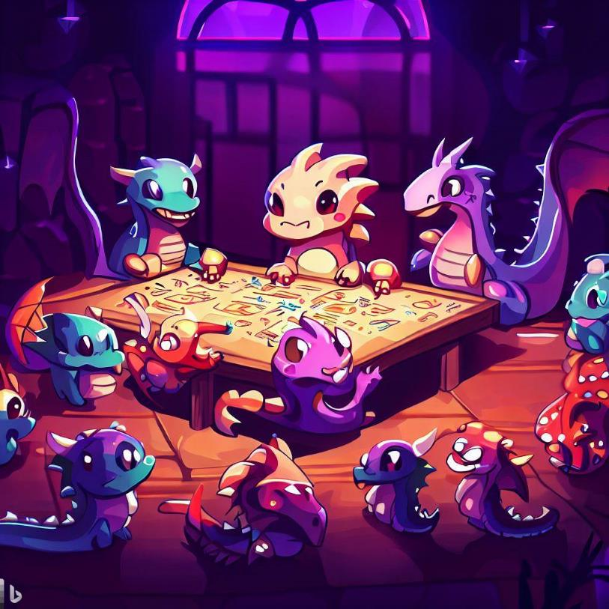
Professional Communication
Teamwork | Professional Communication | Diversity | Emotional Intelligence | Bringing to Work | Q&A
Notes:
<william>
Being an engaging presenter is a valuable life, work, and gaming skill.
Running and playing at a gaming table with friends since I was ____ helped me develop a comfort level with my own voice, with improv, and the ability to react to sudden redirections.
Most importantly, it gave me experience with preparation, both before the event with my notes, and organizing my thoughts right before I need to say them.
While delivering presentations, as when playing a game with friends, you want to keep everyone engaged and involved. Storytelling is universal, and everyone loves a good story.

Slide 14
Preparing to Improvise & Human Communication
Prepare to deliver
Be humane
Practice, Practice, Practice
Know your audience
www.aka.ms/TTRPGsForFunAndProfit
Notes:
<william>
As the Main Storyteller in a role playing game, the last thing you want to do is <robot voice> read monotonous, verbatim texts to your table, </robot voice> or to worse, come across as disorganized and disjointed. You want to seamlessly deliver descriptions of anything, even if you’re making them up on the fly. As a player, you want to be creative, and improvise solutions to the problems in the game, more than just swinging a sword.
<click>
As a professional communicator, much of the same applies. Organizations like Toastmasters provide ways to practice your professional communication and public speaking skills in a constructive environment.
But if that's not your thing, you can learn similar lessons through TTRPGs. As the Main Storyteller, by running a table and keeping everyone engaged, you're practicing similar skills that you need when running, say, an executive pitch meeting.
We’ll talk more about practice later, and how it’s important to developing the skills to engage innovation with emotional intelligence skills.
Some of the skills include, first off, being humane.
<click>
Bio-breaks every hour. Just because you can stand and filibuster for 3 hours straight, doesn’t mean they can listen that long.
For virtual arenas, video chat is extremely important. You're missing a lot of information without every human on video. Nobody in the history of communication has ever liked speaking into a speaker phone. Conference calls tends to favor those who already have the loudest voices or most powerful roles. Like __Deepti___ mentioned earlier, in Microsoft Teams and other video, the hand-raise feature is important and an equalizer for these power disparities. <click>
Finally, you must always prep for your audience, and tailor your content and delivery to suit. At the gaming table, some players will be motivated by lots of political intrigue and role-playing, or maybe solving puzzles and riddles, while some are most into combat and looting treasure. Similarly, some folks in an executive brainstorming session are all about the bottom line, some are about building new solutions, and some are about integrations with existing systems. You should know who is motivated by what.
We need to know where everyone is coming from. How can you make sure your pitch appeals to each?

Slide 15
Leadership & Communicating for Creativity
The new employee experience
Progression is important
Priorities, from Low to High
First impressions are important.
Everyone should know what it takes to level up.
Hierarchy of needs enables creativity.
www.aka.ms/TTRPGsForFunAndProfit
Notes:
<william>
Whether you are team lead, a manager, or the Main Storyteller of a tabletop game, there are a lot of things we can do to help our team members have smooth onboarding, career progression, and top performance.
So, let’s talk in this slide about what can we learn from leading games that prepare us for leadership at work.
<click>
Starting a new job, especially at a big company like Microsoft, there's so much to learn and do, onboarding can feel like an avalanche of information. Similarly, a new player at your table may feel an overload of new game system rules, lore, and backstory to consume. In each case, it can be overwhelming and dissuading. Let’s try to remember what it was like to join a new gaming table or start a new job, and empathize with the onboarding stress. This is part of a good first impression for both an employer and a gamer.
By the way, even before the hire, the candidate interview experience is also super important. If you interview someone for hours across multiple days and require a presentation and homework and watching a video and read a book, and then you don’t hire them, that doesn’t reflect well on you, certain rocket company who will remain unnamed.
Similarly, you could easily turn off new players to your gaming table by overloading them with homework, coming across as haughty, unapproachable, super intense, or picky and critical. So, practice a patient pitch to newcomers... both your employees and your players.
<click>
In our careers as well as player characters, understanding the ladder of progression is important. Making sure newcomers know what it takes to get promoted, or level up, is part of rewarding and incentivizing the good behavior. Making sure players know how higher-level characters grow too.
In each case, teammates should foster desirable growth attributes, so that the whole team advances together.
Creating a competitive or cutthroat atmosphere in a team at work makes about as much sense as it does at the gaming table - it doesn’t. Does anyone enjoy being at a tabletop with someone who just wants to lie, cheat, or steal from each other? No! Can you imagine if player characters were constantly backstabbing each other? How would they ever slay a dragon?
<click>
Finally, the hierarchy of needs. For the unfamiliar: something that’s discussed in any management course, there’s this theory of needs that Maslow and others before him theorized. There's a hierarchy of basic human needs. At the bottom of the needs are the most basic physiological needs: food, water, shelter, sleep, etc. These basic needs will always disrupt the highest order priorities… those that involve innovation and self-actualization.
On that hierarchy of needs is both physiological and psychological safety … near the top is a sense of belonging - these are required before we can become our ideal selves, ideal teammates, or champion dragonslayers.
At work, this is why companies have benefits and competitive salaries, and an emphasis on work-life balance. It’s why affordable housing is important, it’s why paid time off and parental leave is necessary.
At the gaming table, sure we have snacks and comfortable chairs, but also, we value each player's freedom to be creative … without being made fun of. Freedom from teasing or infighting or harassment or unwelcome propositioning.
We'll talk more about the importance of psychological safety later, and why it is often taken for granted.
I’ll turn it over to __(Deepti)_ now to build on what we’ve learned so far about teamwork, creative freedom, and emotional intelligence.

Slide 16
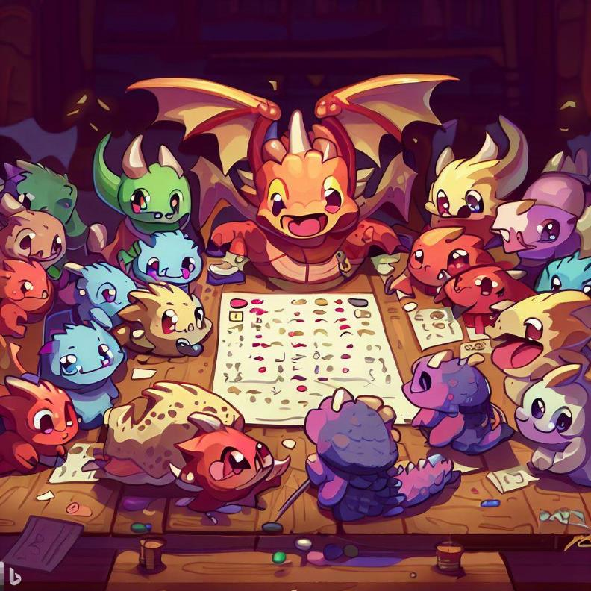
Diversity
Teamwork | Professional Communication | Diversity | Emotional Intelligence | Bringing to Work | Q&A
Notes:
<deepti>
We've talked about teams. Let's talk more about how diversity can make or break a team of co-workers or co-adventurers. A diverse set of backgrounds, experience, and skills make for a balanced team that can overcome great challenges.

Slide 17
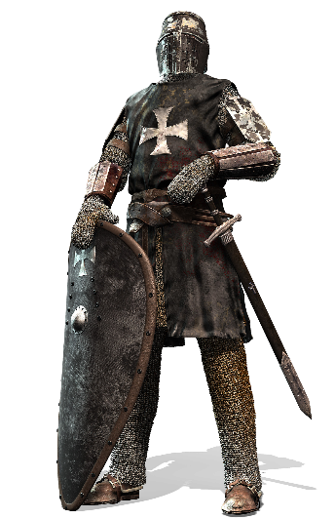
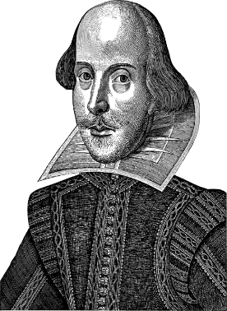
One-dimensional teams
Notes:
Imagine a party of warrior fighters who are all very strong. Could take on the king’s guard with no problem.
<click>
Or a party of charismatic, clever, and witty bards. Not so strong, but could talk their way past the king’s guards with no problem.
There are some challenges each of these teams will excel at, but there are many other challenges these teams would have to avoid, or they will fail.
Now imagine you're on an engineering team at NASA. <click>

Slide 18
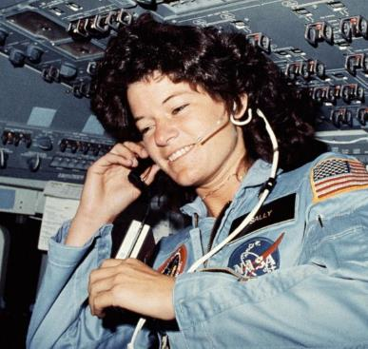

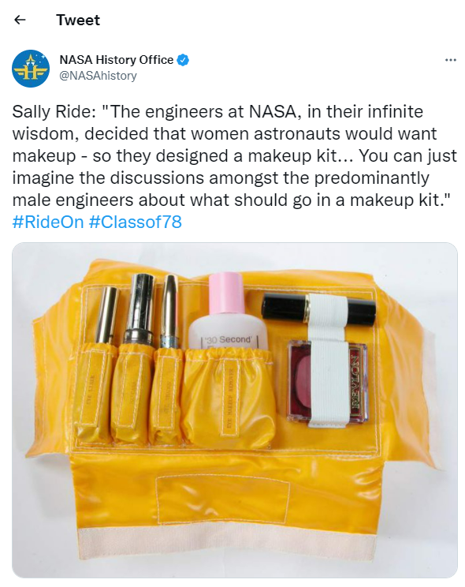

Diverse teams are better at solving problems
Notes:
And this team of NASA engineers is trying to figure out what Sally Ride, the first female shuttle astronaut, would need to bring with her, for 14 days in space.
Looking around the room, you realize the whole team is made up of male engineers.
That very real, very-not-diverse team of NASA engineers guessed – incorrectly - that Ride would need
<click>
100 tampons for just a 2-week trip and a
<click>
custom-designed face makeup kit in space. Now imagine what any woman would have told that team of engineers… if only they had the chance.
In a game, having a party with diverse skills is crucial, for needing to lift the castle's portcullis, or recognizing the poison dart trap, or identifying the mysterious symbols on the wall.
Similarly, we need a broad range of talents and perspectives in the workplace to provide reliable products and services to everyone.

Slide 19
Diversity matters to teams
Playing style
Diversity
Team member diversity
Character skill diversity
Team skill diversity
www.aka.ms/TTRPGsForFunAndProfit
Notes:
And hey, that supports one of our core goals at Microsoft – building on the success of others.
At the gaming table and in the workplace, you should aim for a diversity of background, experience, and skillsets.
This not only creates a strong group of characters and co-workers, but also helps everyone on the team empathize with customers, ultimately doing better work in the long run.
This is why good companies cast wide nets in recruiting efforts, nets that avoid recruiting exclusively from elite schools, that include nontraditional candidates, candidates skilled through alternative routes, Historically Black Colleges and Universities, career switchers, veterans, international candidates. The best teams have a variety of backgrounds and lived experiences, and are better able to view problems from a variety of lenses, not just the lens of a dominant majority.

Slide 20






Diversity ≠ A Single Identity
Bring your whole self to the table
We are a product of our identities
www.aka.ms/TTRPGsForFunAndProfit
Notes:
<Deepti>
But having a diverse team on paper is only a part of the solution. If we treat DEI initiatives like a quota to fill rather than a real opportunity to shift our thinking, then we’re doing a disservice to others and ourselves.
<Click>
we should be encouraging our teams to bring their whole selves to work, not just the parts of their background that could help on paper, because you never know how one’s individual experiences may help.
In TTRPGs, there’s a reason characters are given a backstory and aren’t just reduced into their stat blocks and classes. A sorcerer who grew up on a sheep farm might use herding tactics from their youth to corale a swarm of monsters in battle, or a barbarian who shares a similar childhood trauma to the BBEG might be able to connect with them better than the party’s bard.
<click>
Everyone is a product of their identities, not a sum , and understanding how they intersect makes it easier to create a more welcoming space for everyone.
As a queer woman in tech, I am a part of the minority and it can be difficult to find others like me in my field. But as a South-Asian person in tech, I see myself constantly represented in the workplace.
I can be in both the majority and minority, which helps me not only see the importance of promoting diversity in work but also gives me the opportunity to make space for others in areas where I am privileged.
Christine will expand on this point and tell us how psychological safety is vital to creating an inclusive environment.

Slide 21
Psychological safety in teams and at gaming tables
Feeling included
Crucial to collaborative creation
Often taken for granted by members of the majority
Focus on solutions, not blame
Safety to Challenge and Create
Safety to Learn and Grow
www.aka.ms/TTRPGsForFunAndProfit
Notes:
<Christine>
A final note on why diversity matters to individuals on teams and at gaming tables.
Psychological safety is crucial.
As William mentioned earlier, psychological safety is near the top of the Maslow hierarchy. Organizational behavioral scientist Amy Edmondson of Harvard first introduced the construct of "team psychological safety." She defines it as “a shared belief held by members of a team that the team is safe for interpersonal risk taking.” Psychological safety is a social environment, where everyone feels included and safe to learn, contribute, and create. We can't improvise or innovate if we don't feel safe. (She has a book called The Fearless Organization which is a very good read more about this concept.)
Un-inclusive or discriminatory behaviors -- like for example, casual misogyny in jokes -- leads to exclusion, which leads to a lack of psychological safety. And that stifles creativity and productivity. It may mean that someone may weigh their participation against that discomfort. Then they may participate uncomfortably, or not at all. I don't think anyone actively wishes our team members to be uncomfortable when they join us, so it's important to recognize the value they bring to the team and be sure we're welcoming and inclusive.
Of course, it’s possible for anyone to feel they aren’t psychologically safe, depending on the environment, management expectations, interactions with our peers, or physical insecurities.
For example, in your work perhaps there's project post-mortems, retroactive meetings, discovery sessions, and troubleshooting root cause analysis and those are never good places to point fingers.
Focusing on solutions instead of blame-storming creates an environment where mistakes are safe, where penalties and embarrassment aren’t needed, and where we're free to create and try, we're free to roll a 1 … and instead of bashing the dragon with our axe, we stub our toe and fall down the cavern in a hilarious way. And everyone learns and laughs and has a great story to tell, and we move on.
In one of my companies I worked for we had a ritual called "the fail cake" - and it was when someone took a chance to try out something new, but then maybe it didn't work out very well. One of us would go to the store, grab a sheet cake, put "At Least You Tried" ala The Simpsons, and we'd all eat cake. But this hilarious event was a way we as a company acknowledged that "hey, mistakes happen" and rather than fill our team mates with guilt and shame – we offered support and opportunity to learn. And that it was safe to take risks, and to learn and grow.
I’ll now pass it off to Nina to get us started on talking about emotional intelligence...

Slide 22
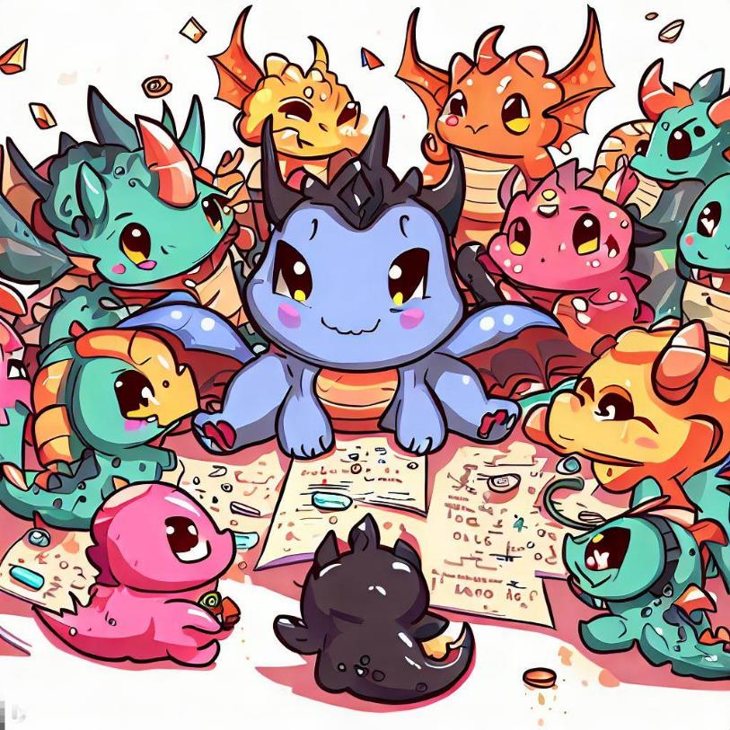
Emotional Intelligence
Teamwork | Professional Communication | Diversity | Emotional Intelligence | Bringing to Work | Q&A
Notes:
<nina>
Thanks Christine. Emotional Intelligence is kind of our thesis today– that table top roleplaying games can help you practice emotional intelligence, a skill that we can all get better at.

Slide 23
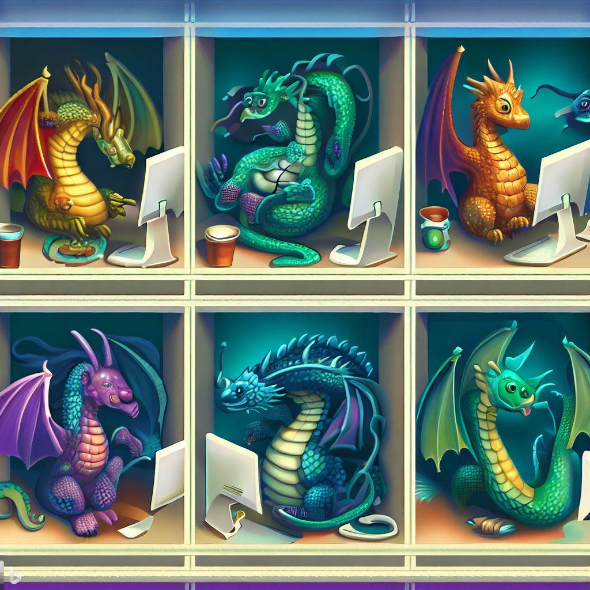
“It’s difficult to build technology that serves the world without first building a team that reflects the diversity of the world… A more diverse group of researchers and engineers is more likely to recognize and think harder about bias problems that may even impact them personally.” Brad Smith, Microsoft President Tools and Weapons (2019)
Notes:
<Nina>
Microsoft’s own President, Brad Smith, wrote in his 2019 book, that it’s difficult to build technology that serves the world without first building a team that reflects the diversity of the world… A more diverse group of researchers and engineers is more likely to recognize and think harder about bias problems that may even impact them personally. This really shows the relationship between the need for diverse teams, as well as emotional intelligence--but what is emotional intelligence? Christine?

Slide 24
Practicing emotional intelligence
Skill sets of emotional intelligence
Self-awareness
Self-control
Motivation
Interpersonal skills
Empathy
Emotional intelligence is "self-mastered“. Empathy can be practiced.
www.aka.ms/TTRPGsForFunAndProfit
Notes:
<Christine>
Emotional Intelligence has been around as a concept for a long time...
Dr Daniel Goleman is a psychologist who wrote the 1995 book Emotional Intelligence, which started to popularize the idea. Goleman's 5 skill sets of emotional intelligence are self-awareness, self-control, motivation, interpersonal skills and empathy.
In this context, empathy means being able to read and recognize the emotions of others and respond to them appropriately.
Additionally, we can exercise self-control is a useful tool in the workplace and can be actively practiced at the role playing table… Are you a person who always wants to jump in and solve that issue at work rather than reflecting or talking against others. Maybe, practicing not rushing into a hoard of Bugbears will help you learn the skill of wait and conferring with others.
<click>
The researchers indicated that emotional intelligence is "self-mastered" – it can be learned; through education and practice, a person can learn empathy and the other emotional intelligence skills.
So the short answer is: Yes! Emotional Intelligence can be practiced, can you can get better by practicing. And Dr. Goleman has some great resources that talk all about that.
<click>

Slide 25
Emotional Intelligence at work
Teamwork
Emotional Intelligence
Professional communication
Diversity
www.aka.ms/TTRPGsForFunAndProfit
Notes:
<Christine>
And emotional intelligence is needed in almost every aspect of our work from teamwork to professional communication and to create, maintain, and foster diversity – and that can be diversity of thought, or diversity of race, religion, gender and so on.
Whenever we're collaborating or presenting, we should practice emotional intelligence. Using empathy, for example, helps us to consider the audience or player's experiences and problems, successes and achievements, and gauge their expectations to design a better experience for everyone.
So, we can get better at emotional intelligence through skill building.

Slide 26
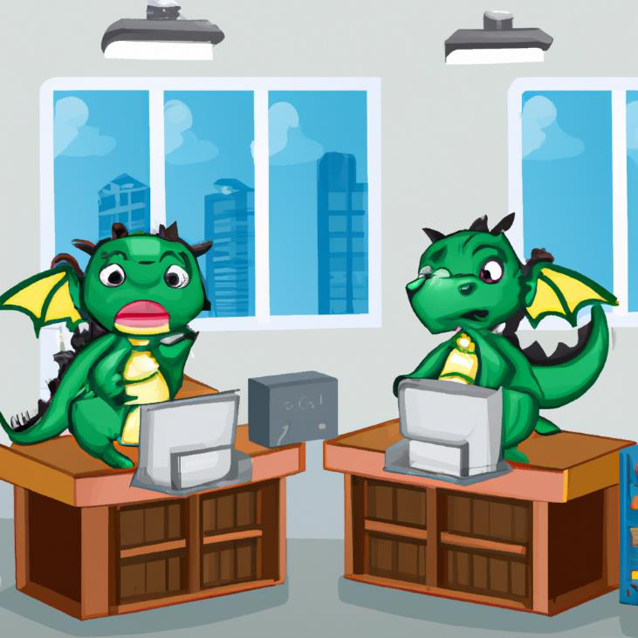
Skill Building
Adult learners learn best when :
They set their own goals and have self-direction.
Enjoy the learning
Are problem solving
See the training as applicable.
Generated by AI in PowerPoint
www.aka.ms/TTRPGsForFunAndProfit
Notes:
<Christine>
So what does skill building have to do with gaming?
In instructional design, years of research have shown us that adult learners learn best when :
They set their own goals and have self-direction.
Enjoy the learning
Are problem solving
And see the training as applicable.
In fact, we learn better when we’re having fun. Motivation and self-efficacy (a person’s belief that they can do that thing) are integral to learning and skill development.
Organizations and Training & Development professionals, such as myself, are constantly trying to find creative and fun ways to skill develop.
PepsiCo took it’s Lean Six Sigma training to Minecraft to both solve virtual training but also because it created a place of curiosity and innovation.
Walmart launched a VR training program in 2018 regionally. Not only did this solve regional training issues they faced, but it also gave a self-paced way of learning.
Secondly, skills are transferrable. Many of you may have hobbies – fishing, or knitting, or painting. In a study from 2014, Org Pyschs studied a group of workers who had hobbies and a group who didn’t’s and they noted a significant different in recovery experiences (i.e., mastery, control, and relaxation) and performance-related outcomes (i.e., job creativity and extra-role behaviors). We this tells us is that we tend to being all our skills to work, we’re not partitioned, what we learn personally can help us professionally
And just like any other skill, practice and learning through experience is necessary before we can create and improvise ourselves.
<send back to Nina> (https://bpspsychub.onlinelibrary.wiley.com/doi/abs/10.1111/joop.12064)

Slide 27
Practicing emotional intelligence through TTRPGs
Adult learners learn best when:
Setting personal goals
Quests, campaigns, and adventures
Having self-direction
Open-world exploration
Enjoy the learning
A fun time playing!
Problem solving
Literally puzzles, or combat, or other situations to navigate
Understanding how training is applicable
Playing with intention
www.aka.ms/TTRPGsForFunAndProfit
Notes:
<nina>
There are countless parallels between emotional intelligence and table-top roleplaying games.<click>
As Christine just outlined, there are a few ways that help adult learners, or players, learn better. <click>
Players can set personal goals like quests, or complete bigger goals like campaigns.<click>
Players have self-direction in TTRPGs since most of them revolve around one grand idea: a game where you can do anything.<click>
Players enjoy the learning since everyone chooses to join the gaming table, and wants to play their characters.<click>
Players are constantly problem solving, whether that's literally puzzles they need to figure out to open a door, or competing in combat, or even engaging in dialogue with other characters—players are problem solving all over the fictional and real world.<click>
Lastly, and most importantly, to use TTRPGs to build emotional intelligence, all players should go in with the understanding that they are playing with the intention of practicing emotional intelligence. Some players play these games to build the strongest or smartest characters, but that's not what we're here to do—to build emotional intelligence while playing TTRPGs, go into the game wanting to empathize with your character specifically. Then, after you've gotten used to that, try empathizing with the other characters. Why might they be making the decisions they are? Why should one character get the chance to talk to the royalty while others might not? TTRPGs add a level of abstraction that makes it easier to talk about why characters may do certain things, and practice empathy and hone our emotional intelligence.

Slide 28
Emotional Intelligence & Design
Design thinking, also associated with:
Human-centered design
User-centered design
Strategic design
Design-based learning
Emotional intelligence
Who is this for?
What will they use it for?
When will they use it?
Why will they use it?
How will they use it?
www.aka.ms/TTRPGsForFunAndProfit
Notes:
<nina>
But what does emotional intelligence have to do with design? There’s a thought-framework, known as “Design thinking” that is helpful here.<click>
It’s also commonly paired with human- or user-centered design, strategic design, and design-based learning, but at it’s core, Design Thinking is a process we all can use to improve the content, products, and games we play. As Wikipedia so eloquently puts it: "The process [of design thinking] may also be thought of as a system of overlapping spaces rather than a sequence of orderly steps... Projects may loop back through inspiration, ideation, and implementation more than once as the team refines its ideas and explores new directions."
Design thinking puts an emphasis on the holistic experience we're designing. Whether that's writing documentation for engineers, designing a new feature for users, or telling a story for our friends, design thinking is a thought-framework we can use to make a better experience for everyone.
And to make a better experience, we need to have high emotional intelligence. We need to be able to consider: "What have the engineers made?" Or "What audience is this new feature for?" Or "Why am I telling my friends this story?" <click>
As we work with other people in almost any context, we need to be able to put ourselves in their shoes, to consider how best to communicate information to them. By asking ourselves who, what, when, why, and how, we can craft better experiences. By practicing and improving our emotional intelligence, we can get better at asking these questions, and implementing them in our work for a better experience for everyone.

Slide 29
“Learning how people adapt to the world around them means spending time understanding their experience from their perspective.
When done well, we can recognize more than just the barriers people encounter. We also recognize their motivations that all people have in common.”
Microsoft Design Inclusive toolkit
Notes:
<nina>
That’s the core of our message today, that as players and storytellers at tabletop games, we can get better at emotional intelligence, and that makes us better at our real life jobs at Microsoft or elsewhere. This quote from the Microsoft Design Inclusive emphasizes that when we empathize with others, we not only recognize their barriers, but also their shared, common motivations. And from that, we can design better experiences, and practice skills we all want to get better at.

Slide 30
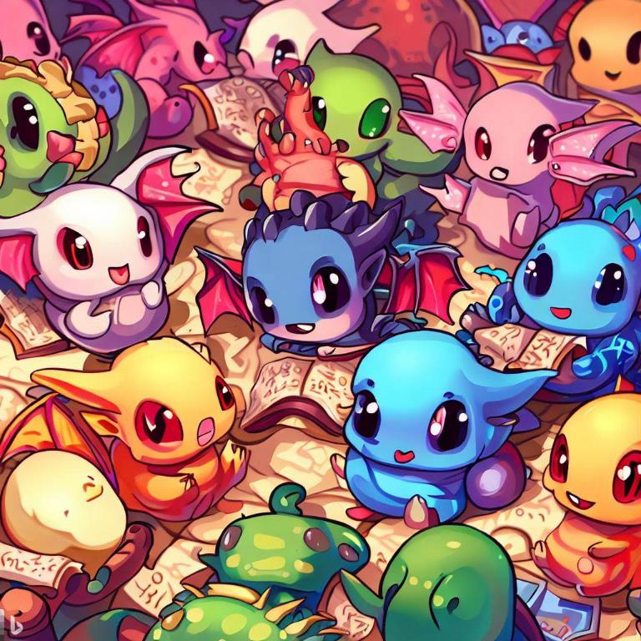
Bringing to Work: What can I do right now?
Teamwork | Professional Communication | Diversity | Emotional Intelligence | Bringing to Work | Q&A
Notes:
<nina>
So now you've heard all the reasons you should bring table-top roleplaying games to your work for both personal and professional development, Let's get into how you can take action right away to start playing TTRPGs with your coworkers.

Slide 31
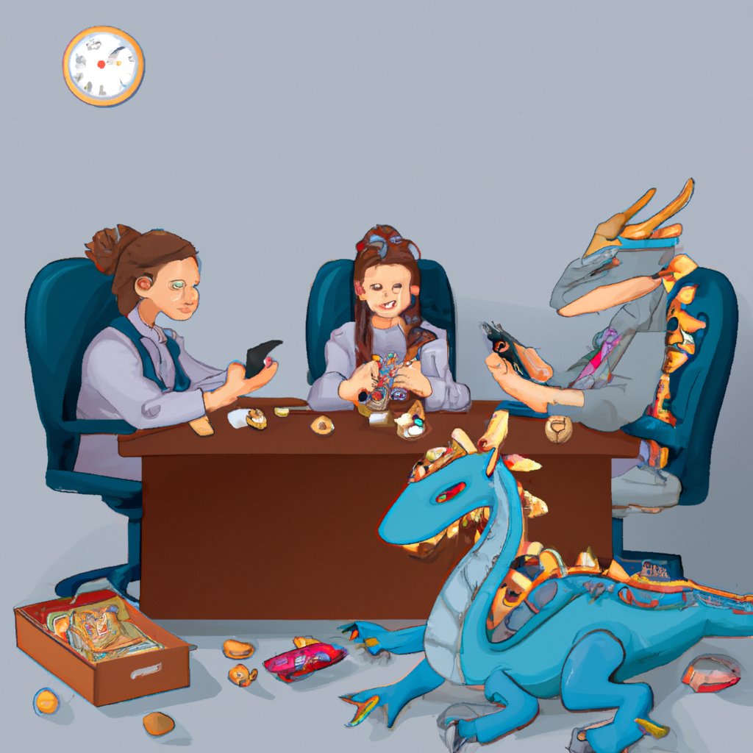
Playing TTRPGs at work
Start small
Find others interested in TTRPGs
Play one-shots and short games
Follow the fun
Play what players want
Meet the demand
Outreach & spreading the word
Play games at organizational events
Tell people that you play
www.aka.ms/TTRPGsForFunAndProfit
Generated by AI in PowerPoint
Notes:
<nina>
<click> We recommend starting small. At Microsoft, there was a small group of people who started playing a Dungeons and Dragons campaign who eventually wanted to reach a broader audience and become the vehicle for others to form their own campaigns. They call themselves the 'Storytellers Guild', and what started as just 5 people playing weekly now has over 200 members ranging from people just learning about TTRPGs for the first time, to players in campaigns, to forever DMs wanting to hone their craft. And we made sure to not outgrow ourselves—instead of trying to start with multiple simultaneous campaigns all at once, or huge projects like a West Marches style campaign with multiple DMs, we instead opted for one-shot games that can be played in a single evening (ideally 4 hours or less), micro-RPG sessions, weekly talks about our TTRPG experiences, and other low-pressure, low-commitment ways for people to show their interest. Then naturally, members started forming their own campaigns around shared interests, and the Guild grew from there.
<click>
We also made sure to follow the fun. In the same vein as running one-shots because they're low commitment, we noticed that our members were not engaging with bigger, grander ideas, like a Family Night where parents and kids could play a TTRPG together. As it turns out, schedule is difficult, people are busy, and although they say they want to be involved in TTRPGs, they don't have the time. So we found that one-shot events was what they wanted, and when enough players, maybe 4 or 5, showed interest in a new game, we'd facilitate that too. <click> Finally, out reach is the real secret here. Everyone in the Guild is excited to be part of it, and we are loud and proud with out love for TTRPGs. Everyone on my team knows that I'm the go-to person about any TTRPG, or even video game or board game. I built that brand by posting about it in chat during team-building events, offering to run games for co-workers, and speaking at conferences (like this one). But you don't have to go so far as organize your own games—honestly, just telling people that you're interested in TTRPGs usually starts a conversation: either they say, "Oh wow, tell me more," or "I play too!". And in either scenario, you can tell them about you'd like to play TTRPGs at work to build skills. It's really about bringing your whole self to work, if you feel comfortable doing so. And for most people, playing a fun game to practice skills you want is a win-win.

Slide 32
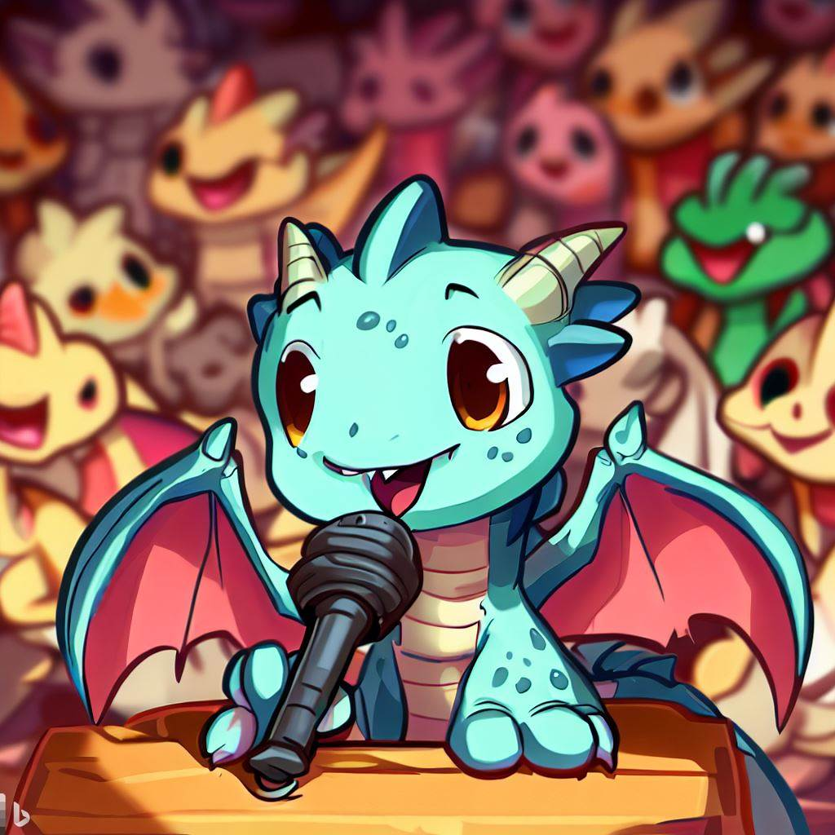
Q&A
Join us for a game @ 2:30pm
At the "Free Play" tables
New players welcome!
We'll play Lasers & Feelings
Fill out our survey & ask questions (anonymously)
Survey and Q&A
www.aka.ms/
TTRPGsForFunAndProfit
Teamwork | Professional Communication | Diversity | Emotional Intelligence | Bringing to Work | Q&A
Notes:
<nina>
So, we hope you’ve had as much fun today as we have, and we hope you’re inspired to start your own RPG tables at work or at home. If you'd like to play a game with us, we'll be at the Free Play tables at 2:30pm today. New players are always welcome, and we'll be playing the easy table-top roleplaying game "Lasers and Feelings". Also, please fill out the anonymous survey so we can learn more about you all as an audience, you can ask questions anonymously, and you can let us know if you'd like to play with us. Right now, we're happy to answer any questions you have about TTRPGs in the workplace, and we hope you've enjoy our talk today.
What other parallels to do you see between what skills we have in gaming and at work?
How can we make TTRPGs approachable? How can we engage co-workers who have never played TTRPGs before?
What are some examples from Delve or other events that you'd like to share about people learning skills?

Slide 33
Bradberry, Travis and Jean Greaves. Emotional Intelligence 2.0. TalentSmart, 2009. https://www.jstor.org/stable/2666999
[STUDY] Hobbies & Work: https://bpspsychub.onlinelibrary.wiley.com/doi/abs/10.1111/joop.12064
[BOOK} Working with Emotional Intelligence by Daniel Goleman: https://www.amazon.com/Working-Emotional-Intelligence-Daniel-Goleman/dp/0553378589
[VIDEO} Daniel Goleman HBR: https://hbr.org/video/2838341939001/leaders-need-three-kinds-of-focus
[BOOK] Developing Management Skills: https://cmls-global.com/wp-content/uploads/2018/02/Developing-Management-Skills-for-Decisions-Making.pdf

